Slide 1
SRHR Health Workforce Modelling Initiative for WHO AFRO Region
JKUAT Team

Slide 2
Pillar 2 Strengthening health workforce development for SRHR
Evidence synthesis
Develop and validate models
Evidence into policy action
Regional capacity
Conduct a comprehensive evidence synthesis on the SRHR workforce status, gaps, and training pathways in the African Region
Develop and validate analytical models to quantify workforce supply, demand, and return on investment (ROI).
Translate evidence into actionable policy tools (dashboards, briefs, algorithms) for regional stakeholders.
Build regional capacity through dissemination of knowledge products

Slide 3
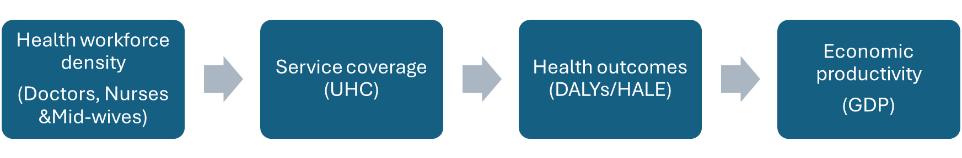
Econometric Modelling-three-stage least squares (3SLS) model
Objective
To identify and quantify the structural relationships linking:
Why 3SLS?
The variables influence each other simultaneously (correlated errors)
3SLS allows joint estimation
Outputs
Short-run elasticities
Long-run multipliers
Dynamic persistence parameters

Slide 4
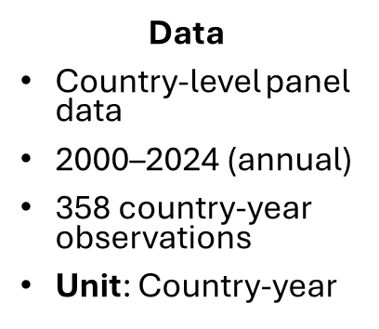
Preliminary results
UHC dynamics
DALY’s equation
Productivity equation
Model:
$$UHC_{t}​=f(UHC_{t−1}​,Doctors_{t},Nurses_{t},GDP_{t})$$
𝑈𝐻𝐶_𝑡 ​=𝑓(𝑈𝐻𝐶_(𝑡−1) ​,𝐷𝑜𝑐𝑡𝑜𝑟𝑠_𝑡,𝑁𝑢𝑟𝑠𝑒𝑠_𝑡,𝐺𝐷𝑃_𝑡)
Estimates
$$lag UHC=0.962 (<0.001)$$
𝑙𝑎𝑔 𝑈𝐻𝐶=0.962 (<0.001)
$$Doctors=0.030 (0.413)$$
𝐷𝑜𝑐𝑡𝑜𝑟𝑠=0.030 (0.413)
$$Nursing \& midwifery ={0.031}^{∗} (0.04)$$
𝑁𝑢𝑟𝑠𝑖𝑛𝑔 & 𝑚𝑖𝑑𝑤𝑖𝑓𝑒𝑟𝑦 =〖0.031〗^∗ (0.04
$$GDP=−0.080(0.70)$$
𝐺𝐷𝑃=−0.080(0.70)
UHC changes slowly over time. Expansion of nursing workforce significantly improves service coverage. Doctors appear less influential in short-run UHC expansion
UHC changes slowly over time. Expansion of nursing workforce significantly improves service coverage. Doctors appear less influential in short-run UHC expansion
Interpretation:
Interpretation:
$GDP not directly driving UHC$
GDP not directly driving UHC
$$log⁡(DALYst​)=f(DALYs_{t−1}​,UHCt​,GDP_{t})$$
log⁡(𝐷𝐴𝐿𝑌𝑠𝑡​)=𝑓(𝐷𝐴𝐿𝑌𝑠_(𝑡−1) ​,𝑈𝐻𝐶𝑡​,𝐺𝐷𝑃_𝑡)
Interpretation:
Model
Estimates
$$Lag DALYs={0.98}^{∗} (<0.001)$$
𝐿𝑎𝑔 𝐷𝐴𝐿𝑌𝑠=〖0.98〗^∗ (<0.001
$$UHC=0.00019(0.07)$$
𝑈𝐻𝐶=0.00019(0.07)
$$GDP={0.0034}^{∗} (0.017)$$
𝐺𝐷𝑃=〖0.0034〗^∗ (0.017
Disease burden is extremely persistent
UHC does not immediately reduce DALYs
GDP associated with slight DALY increase
Model
$log⁡(Productivity_{t}​)=f(Productivity _{t−1}​,DALYs_{t}, HALE_{t})$
log⁡(𝑃𝑟𝑜𝑑𝑢𝑐𝑡𝑖𝑣𝑖𝑡𝑦_𝑡 ​)=𝑓(𝑃𝑟𝑜𝑑𝑢𝑐𝑡𝑖𝑣𝑖𝑡𝑦 _(𝑡−1) ​,𝐷𝐴𝐿𝑌𝑠_𝑡, 𝐻𝐴𝐿𝐸_𝑡)
Estimates
$$Lag productivity={0.986}^{∗} (<0.001)$$
𝐿𝑎𝑔 𝑝𝑟𝑜𝑑𝑢𝑐𝑡𝑖𝑣𝑖𝑡𝑦=〖0.986〗^∗ (<0.001)
Interpretation:
Productivity is extremely persistent
Disease burden significantly reduces economic productivity
$$DALYs={0.134}^{∗} (0.026)$$
𝐷𝐴𝐿𝑌𝑠=〖0.134〗^∗ (0.026
$$HALEs =−.0.014 (0.31)$$
𝐻𝐴𝐿𝐸𝑠 =−.0.014 (0.31)
$$lag HALE=0.001 (0.94)$$
𝑙𝑎𝑔 𝐻𝐴𝐿𝐸=0.001 (0.94)
DALY’s capture most of the health productivity channel

Slide 5
Cross-equation summary
System R² (OLS): 0.98
McElroy R²: 0.995
The model explains nearly all joint variation across the three endogenous variables
Key Findings
Expanding nursing and midwifery capacity appears more strongly associated with UHC gains
Health system strengthening effects on disease burden appear gradual rather than immediate
Reducing disease burden has measurable macroeconomic productivity effects

Slide 6

Structural estimates as inputs for Agent-based models(discrete time)
3SLS estimates
Elasticities
Calibrate Agent based models
Example transition rule in ABM: $UHC_{t+1}=0.962UHC_{t}+0.031Nurses_{t}$

Slide 7
Evidence Synthesis on SRHR Workforce Status & Gaps (5 African Countries) (Eswatini, Cameroon, Liberia, Nigeria, Uganda)
Country | Workforce Density (per 10k) | Key Gaps | Retention Issues | Disease Pressure
Eswatini | ~51 (improved) | Rural shortages, few specialists | Migration, workload | Very high HIV/TB
Cameroon | ~13–15 | Low doctor density, conflict areas | Insecurity, low pay | Malaria, HIV
Liberia | ~10 | Severe shortages post-Ebola | Low pay, donor reliance | Infectious diseases
Nigeria | ~16–20 | Urban–rural disparity, specialist gaps | Brain drain, strikes | High maternal, malaria
Uganda | ~15–17 | Rural shortages, weak CPD | Migration, dual practice | Malaria, HIV

Slide 8
Summary of synthesis
Most countries are below the WHO threshold.
Severe rural–urban maldistribution.
Nurses and midwives dominate the workforce.
High disease burden (HIV, malaria, TB).
Retention and workload are major constraints
Workforce gaps are not only health system issues-they have measurable long-term economic consequences---based on the 3SLS results

